Slide 1
CC3D/SBML
James P. Sluka
Biocomplexity Institute
Indiana University
Bloomington, IN 47405
USA
Based on a presentation developed by Julio Belmonte
EMBL
Heidelberg
Germany
Bloomington IN, US
August 2018
Support: NIGMS-R01GM076692, [NIGMS-R01GM077138], NIH-U01-GM111243, NIGMS-R01 GM122424, [Falk Medical Research Trust], IUCRG, [NSF], [US EPA], EMBL-Marie Curie Interdisciplinary Postdoctoral Fellowship

Slide 2
CPM modeling Scope
Cellular behaviors:
Location
Volume
Shape
Movement
Adhesion
Mitosis
Death
Differentiation
Polarization
Etc…

Slide 3
Subcellular modelling
Biochemical Kinetics:
Cell-Cycle
Circadian rhythms
Cardiac rhythms
cAMP oscillations
Delta-Notch patterning
WNT pathway
FGF pathway
Normal Metabolism
Xenobiotic (drugs, toxicants) metabolism and toxicity
…

Slide 4
Super-cellular modelling
Coupling to whole body models:
Pharmacokinetics (PK)
Physiobiological Pharmacokinetics (PBPK)
Nutrients
Drugs
Toxins and Toxicants

Slide 5
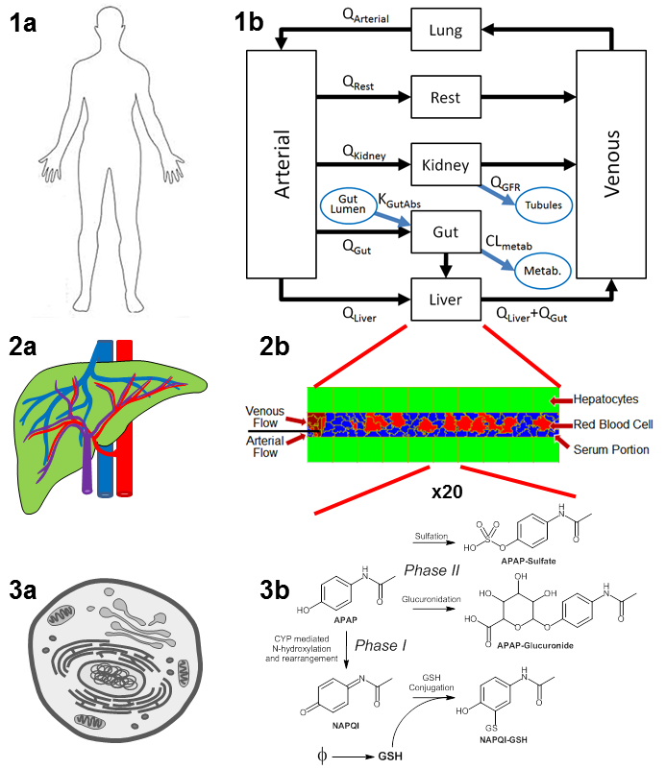
Sub- and Super-cellular modelling
3x
APAP APAPS
APAPG
A Liver-Centric Multiscale Modeling Framework for Xenobiotics
Sluka JP, Fu X, Swat M, Belmonte JM, Cosmanescu A, Clendenon SG, Wambaugh JF, Glazier JA. PLoS One. 2016 Sep 16;11(9):e0162428PubMed PMID: 27636091

Slide 6
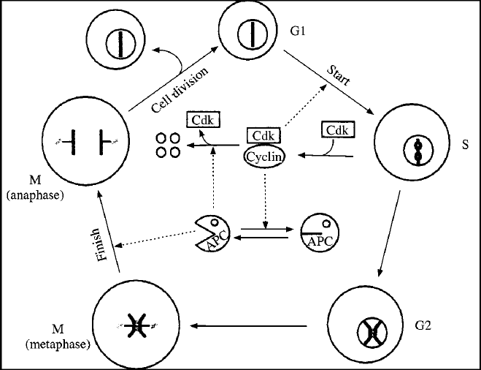
Subcellular modelling
Biochemical Kinetics:
Cell-Cycle
Circadian rhythms
Cardiac rhythms
cAMP oscillations
Delta-Notch patterning
WNT pathway
FGF pathway
Etc…

Slide 7
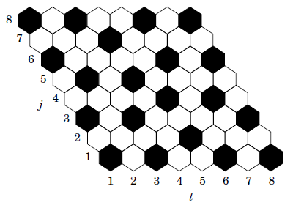
Subcellular modelling
Biochemical Kinetics:
Cell-Cycle
Circadian rhythms
Cardiac rhythms
cAMP oscillations
Delta-Notch patterning
WNT pathway
FGF pathway
Etc…

Slide 8
How to add this into CompuCell?
Just another Python class!
Right your own PDE solver
Too slow (both for the modeler and the computer)
C++ file to be wrapped into Python
Too complicated
Import an SBML solver like Tellurium
Import SBML …

Slide 9
SBML – Systems Biology Markup Language
Not a software!
Machine-readable format for representing ODE based models
Standard for storage and exchange of models
Implementation agnostic
Sites:
SBML.org: The official repository of the specification
BioModels.net: Repository of models in SBML

Slide 10
SBML
How does it work?
Developer software (SBW/Jarnac/Telllerium/COPASI, …)
SBML
Simulation software (CompuCell3D)
(each tool has its own native format)

Slide 11
SBML
Initial conditions:
Parameters:

Slide 12
SBML
<?xml version="1.0" encoding="UTF-8"?>
<sbml xmlns = "http://www.sbml.org/sbml/level2" level = "2" version = "1">
<model id = "cell">
<listOfCompartments>
<compartment id = "compartment" size = "1"/>
</listOfCompartments>
<listOfSpecies>
<species id = "S1" boundaryCondition = "false" initialConcentration = “5.0" compartment = "compartment"/>
<species id = "S2" boundaryCondition = "false" initialConcentration = “0.0" compartment = "compartment"/>
</listOfSpecies>
<listOfParameters>
<parameter id = "k1" value = "0.1"/>
</listOfParameters>
<listOfReactions>
<reaction id = "_J1" reversible = "false">
<listOfReactants>
<speciesReference species = "S1" stoichiometry = "1"/>
</listOfReactants>
<listOfProducts>
<speciesReference species = "S2" stoichiometry = “2"/>
</listOfProducts>
<kineticLaw>
<math xmlns = "http://www.w3.org/1998/Math/MathML">
<apply>
<times/>
<ci>
k1
</ci>
<ci>
S1
</ci>
</apply>
</math>
</kineticLaw>
</reaction>
</listOfReactions>
</model>
</sbml>
Usually you use SBML compliant packages to develop your model (Tellurium, COPASI, …)

Slide 13
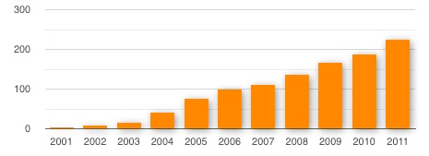
SBML
Total number of known SBML-compatible software packages each year :

Slide 14
How to write SBML?
Bio-Spice
Large collection of tools, integrated via a "Dashboard." Free download (BSD), various platforms.
Teranode
Suite of tools for model management, design, and simulation. (Linux/Mac/Windows) Commercial (30-day trial available).
SBW
Systems Biology Workbench.
Tellurium
COPASI
Check http://sbml.org/SBML_Software_Guide

Slide 15
Integration with CC3D
Reaction kinetic models, or any ODE based model, can be easily added into a CC3D simulation when in SBML format.
Once loaded, the model is converted into a set of ODEs and is solved by the sbmlSolver library inside CC3D.

Slide 16
CC3D+SBML
CC3D:
SBML
Degradation
E2
Activator
E1
S
E3
Metabolism
Gene Regulation
Protein Regulation

Slide 17
Integration with CC3D – External (PBPK)
CC3D:
SBML
Degradation
E2
Activator
E1
S
E3
Metabolism
Gene Regulation
Protein Regulation

Slide 18
Integration with CC3D – cell type
CC3D:
SBML
Degradation
E2
Activator
E1
S
E3
Metabolism
Gene Regulation
Protein Regulation

Slide 19
Integration with CC3D – 1 cell
CC3D:
SBML
Degradation
E2
Activator
E1
S
E3
Metabolism
Gene Regulation
Protein Regulation

Slide 20
CC3D+SBML
CC3D cells, each cell gets its own copy of the SBML:
SBML
Degradation
E2
Activator
E1
S
E3
Metabolism
Gene Regulation
Protein Regulation

Slide 21
class <someClass>(SteppableBasePy):
def __init__(self,_simulator,_frequency):
SteppableBasePy.__init__(self,_simulator,_frequency)
def start(self):
# Define a SBML model
Path = <ModelPath> # Path where the model is stored
Name = <ModelName> # Name of the model
Step = <timeStep> # Time step of integration
# Add SBML model to a cell
self.addSBMLToCellIds(_modelFile=Path,_modelName=Name,_ids=[<cellIds>],_stepSize=Step)
self.addSBMLToCell(_modelFile=Path,_modelName=Name,_cell=<cell>,_stepSize=Step)
# Add SBML model to cell types
self.addSBMLToCellTypes(_modelFile=Path,_modelName=Name,_types=[<Types>],_stepSize=Step)
# Add free floating SBML
self.addFreeFloatingSBML(_modelFile=Path,_modelName=Name,_stepSize=Step)
def step(self,mcs):
# Iterate the model (run it for the time step specified on the load command)
self.timeStepSBML()
# Get the parameter value or molecular concentration from a cell
for cell in self.cellList:
state = self.getSBMLState(_modelName='DN',_cell=cell)
<var> = state[“<molecule>”]
# Set a new parameter value or molecular concentration value for a cell
self.setSBMLValue(_modelName=Name,_valueName=<valueName>,_value=0.1,_cell=cell)
# Copy SBML model from one cell to another
self.copySBMLs(_fromCell=cell1,_toCell=cell2)
self.copySBMLs(_fromCell=cell1,_toCell=cell2,_sbmlNames=[<ModelName1>,<ModelName2>,…])
# Delete a SBML model from a cell
self.deleteSBMLFromCell(_modelName=<Name>,_cell=cell)

Slide 22
Example – Delta-Notch Patterning
Human intestinal crypt cup
Chen et al. MSB (2017)
Hair cells of Drosophila inner ear
Eddison et al. PNAS (2000)

Slide 23
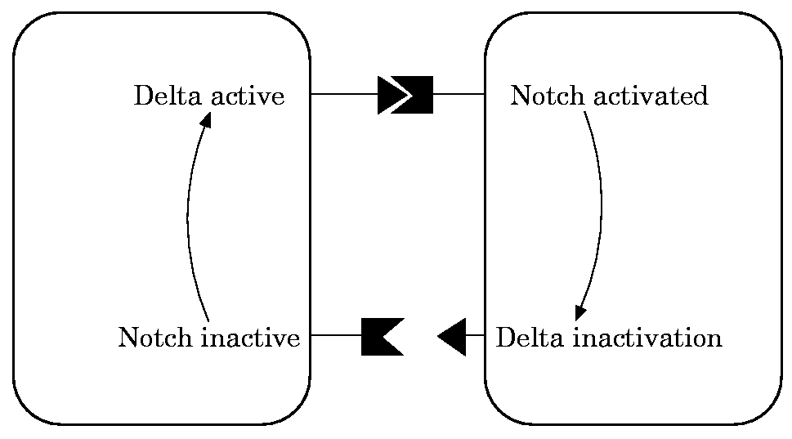
Example – Delta-Notch Patterning
We will use the model published by Collier et al. in 1996:
N : Notch
D : Delta
D: average Delta from neighbors

Slide 24
Example – Delta-Notch Patterning
In this model, when a cell receives high levels of Delta from neighbors its Notch level becomes downregulated.
This leads to the high/low Notch patterning shown by their simulations on an hexagonal lattice:

Slide 25
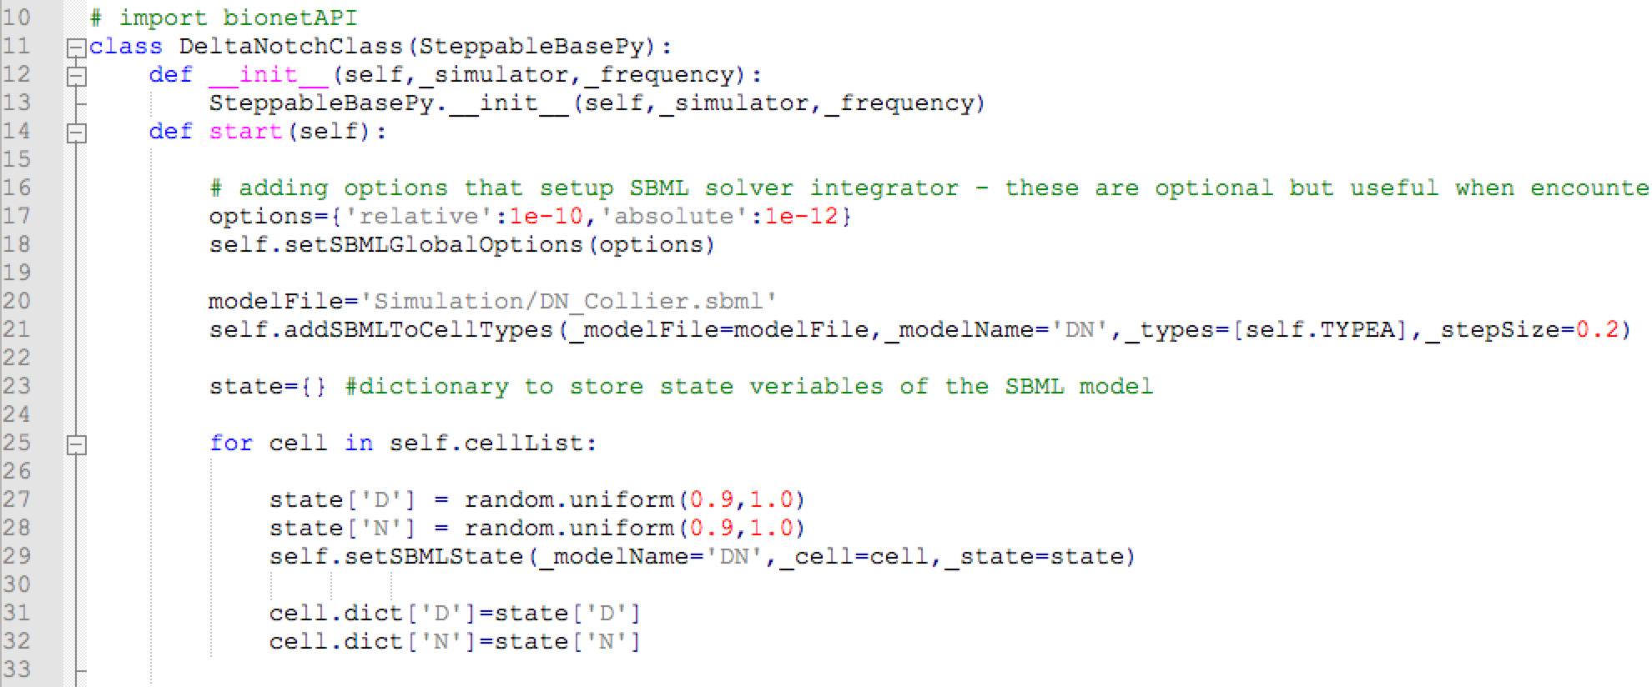
Example – Delta-Notch Patterning
In CC3D we first loop over all cells’ neighbors and store their Delta:
Then we average it and use it as the new D parameter of that cell:
File:
CompuCell3D\Demos\BoolChapterDemos_ComputationalMethodsInCellBiology\DeltaNotch

Slide 26
Example – Delta-Notch Patterning
Next we create a dictionary named “states” to keep the concentration value of all variables of the sbml model (here Delta and Notch levels):
Then we go over all cells, assing a random value of D and N for each cell and add it to the SBML of each cell:
File :
CompuCell3D\Demos\BoolChapterDemos_ComputationalMethodsInCellBiology\DeltaNotch

Slide 27
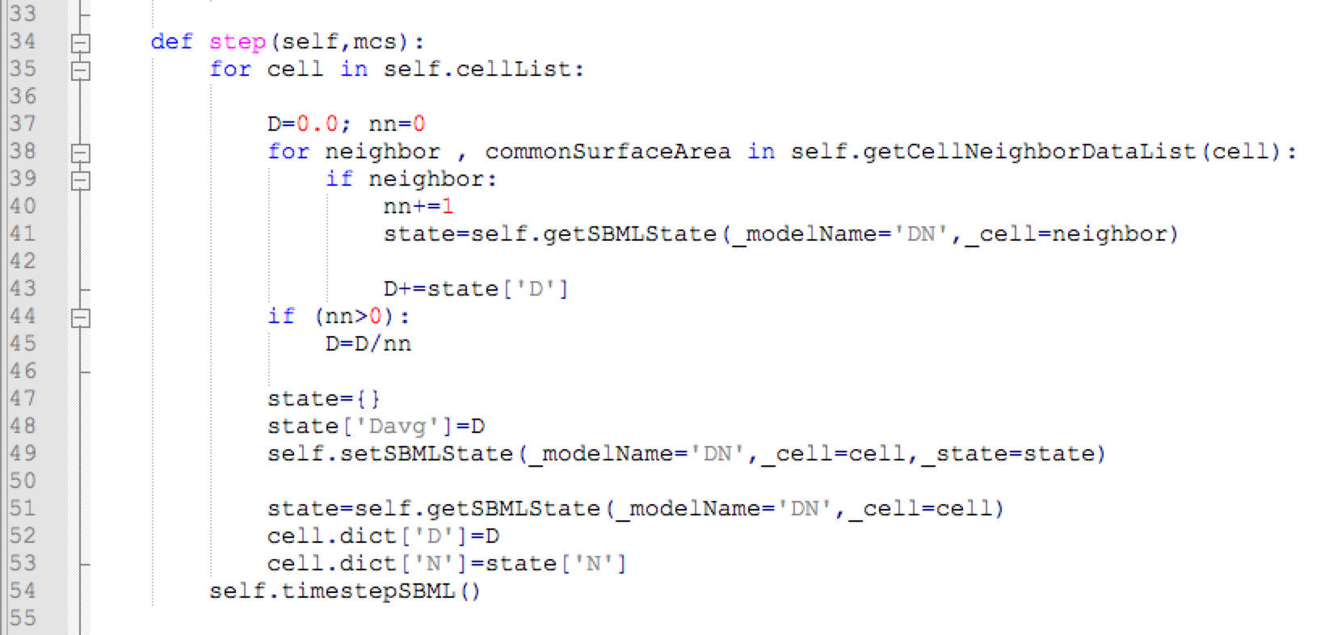
Example – Delta-Notch Patterning
In the step function we go over all cells and read and average the Delta levels of all the cell neighbors:
Then we create a new state dictionary, load it with the average Delta and use it to update the value of the parameter “Davg” of the cells sbml model:
File :
CompuCell3D\Demos\BoolChapterDemos_ComputationalMethodsInCellBiology\DeltaNotch

Slide 28
Example – Delta-Notch Patterning
When we run this model we can see that first the Notch values go down before the pattern emerges:

Slide 29
Example – Delta-Notch Patterning
Increase the level of membrane fluctuations and check how the pattern changes

Slide 30
Second Example – Cell Cycle from web
In our second example we will use a published model for the cell cycle.
The website www.biomodels.org contains a repository of published models in SBML format.
If you wish to submit your own SBML to the repository, follow the instructions at: www.ebi.ac.uk/biomodels-main/submit

Slide 31
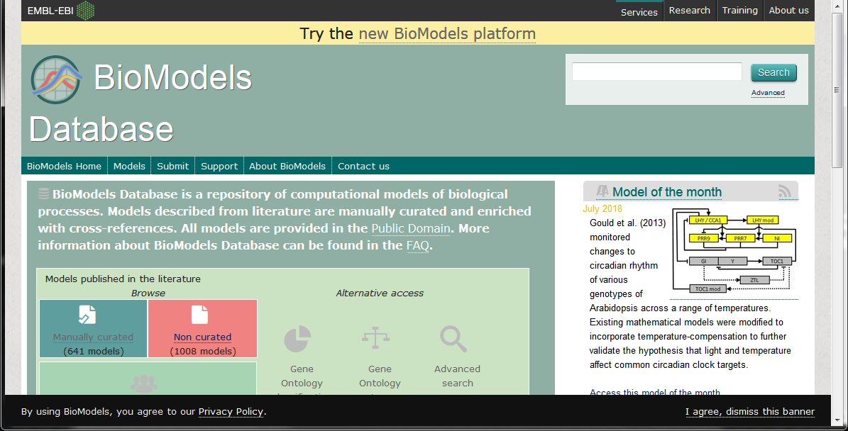
Second Example – Cell Cycle Model
Search for: BIOMD0000000195
(7 zeroes)
biomodels.org

Slide 32
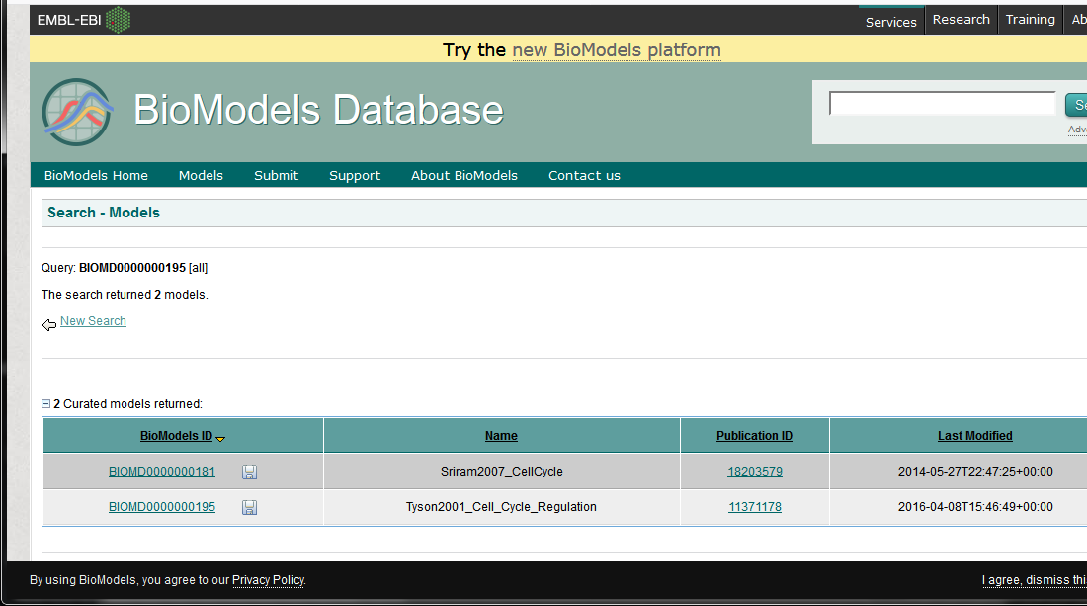
Second Example – Cell Cycle from web
From the model list select the Tyson2001_Cell_Cycle_Regulation

Slide 33
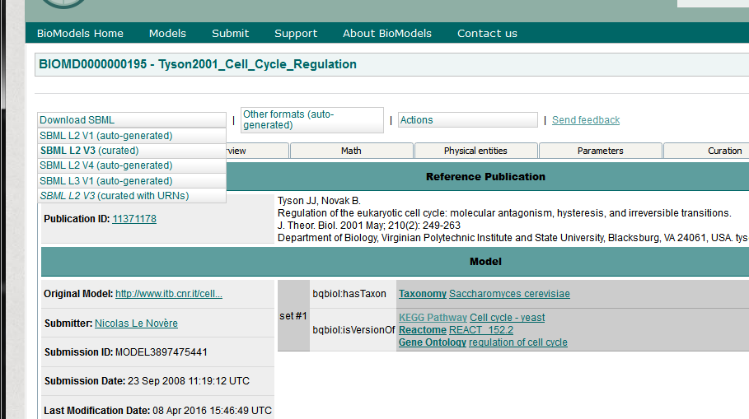
Second Example – Cell Cycle from web
Click on “Download SBML” then select SBML L2V4 from the list
Ignore the warning
Save the file some place convenient

Slide 34
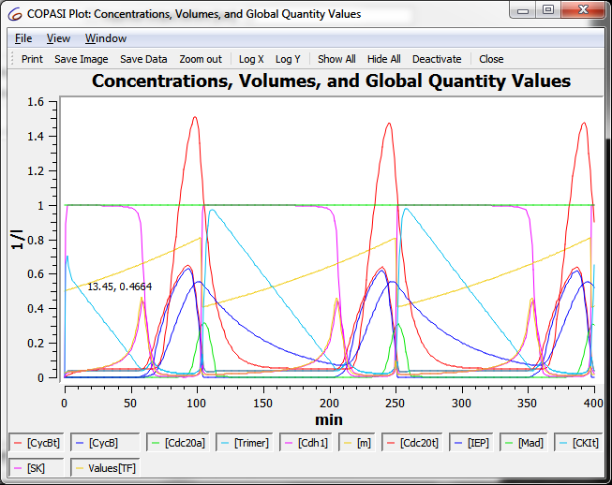
Second Example – Cell Cycle from web
Explore the file in your favorite SBML compliant solver (Tellurium, COPASI, …)

Slide 35
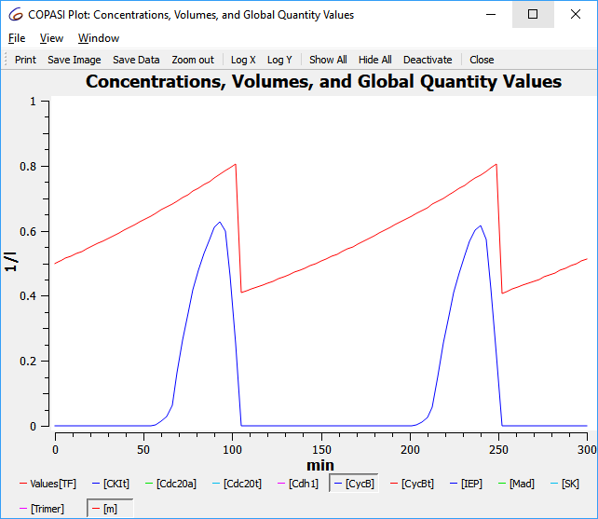
Second Example – Cell Cycle from web

Slide 36
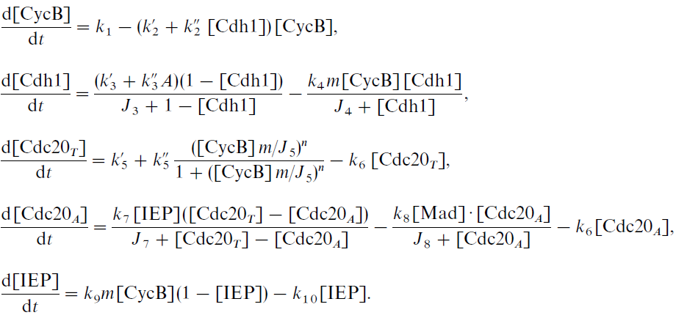
Example – Cell Cycle from web
This model has 5 variables, from which only the first 2 forms the core of the cell cycle oscillations:

Slide 37
Example – Cell Cycle from web
An important feature of this model is the presence of the parameter “m”, which is the normalized total mass of the cell:
This parameter varies between ~0.5 (right after mitosis) and ~1 (at normal size) and corresponds in CC3D to the ratio of volume to the resting volume (initial volume):

Slide 38
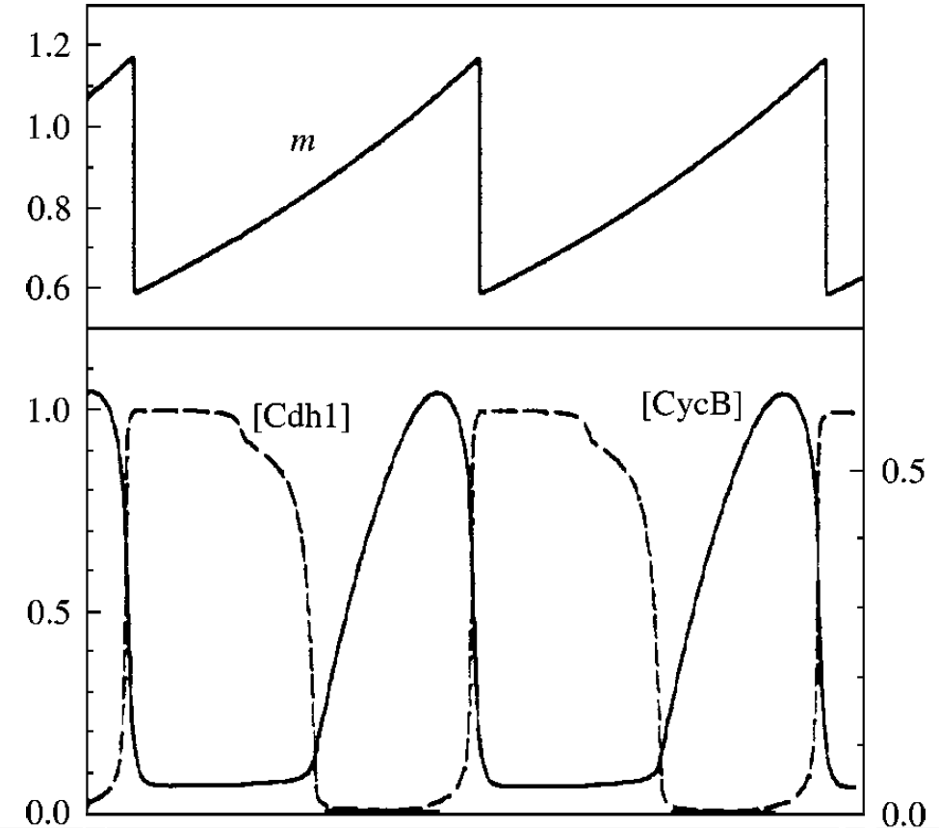
Example – Cell Cycle from web
In this model mitosis occur when the level of CycB drops below 0.1

Slide 39
Create a CC3D
Single cell model (myCell) in Twedit++
Add SBML to the project via Twedit++
Add the SBML model to the one cell
Add visualization field for the cell’s CycB (or for m)
Divide the cell when every time CycB drops below 0.5

Slide 41
Exercise 3 – 2 SBML models
Below is a simulation with Tyson’s Cell Cycle and Collier’s Delta Notch models:

